Slide 1


Slide 2



Project Highlights
Project Name : Test automation for web application testing using protractor, cucumber and JavaScript.
Team Size : 3
Mentor Name: Monica D Anand Ps no : 20140815
Team Members Details
Intern Name:
Mithun MR
PS# 99003716
2002MYSEMBF2
BE In Electronics and Communication
Intern Name:
Shaik Rehana
PS#99003549
2002MYSEMBF1
BE in Electronics and Communication
Intern Name:
Sneha Anand
PS# 99003525
2002MYSEMBF1
BE in Electronics and Communication

Slide 3

Tools Used
Protractor: An End-to-End testing Framework specially designed for Angular and Angular JS applications. It is open-source and built by Google Inc.
Cucumber : A tool based on Behavior Drive Development framework used to write user acceptance tests for web-based applications.
Selenium : A portable framework for testing web applications. It also provides a test domain-specific language to write tests in few of popular programming languages, including C#, Groovy, Java, Perl, PHP, Python, Ruby and Scala. The tests can then run against most modern web browsers such as Chrome, IE and Firefox.

Slide 4
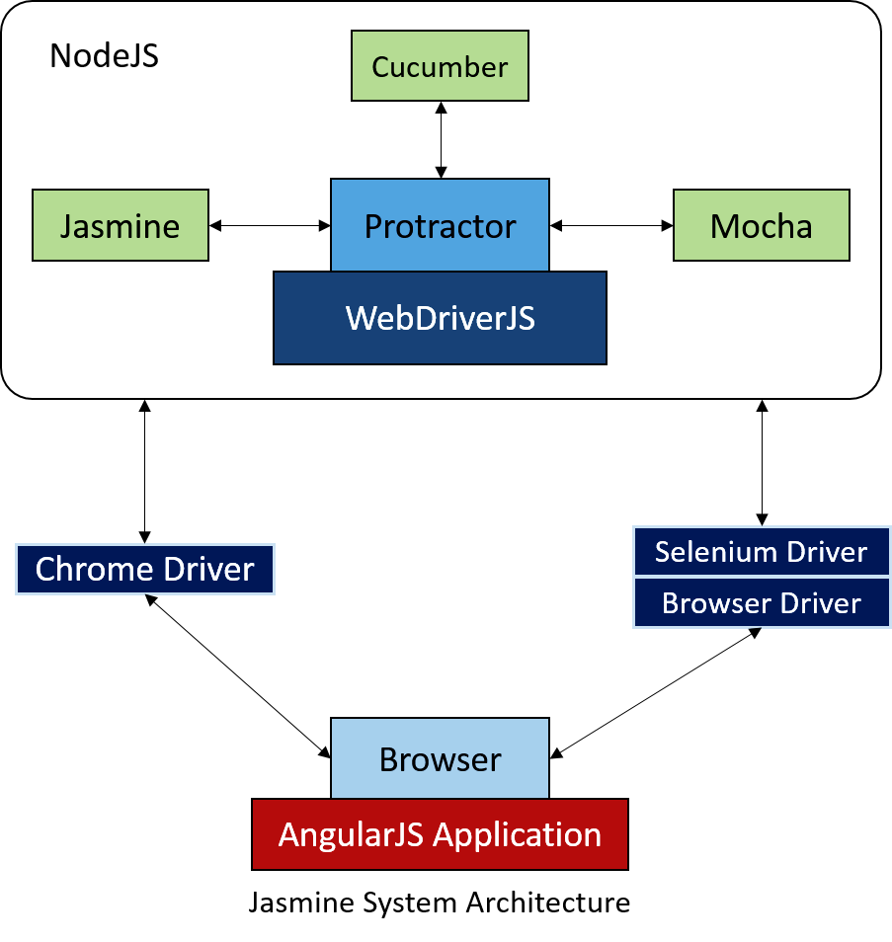
Protractor Framework

Slide 5
Cucumber
Feature(s)
Given
When
Then
And
Scenario
Test Cases
Selenium
JavaScript
Test Runner
To run feature
To generate the output /report
Feature File
Step Definition
Test Runner

Slide 6

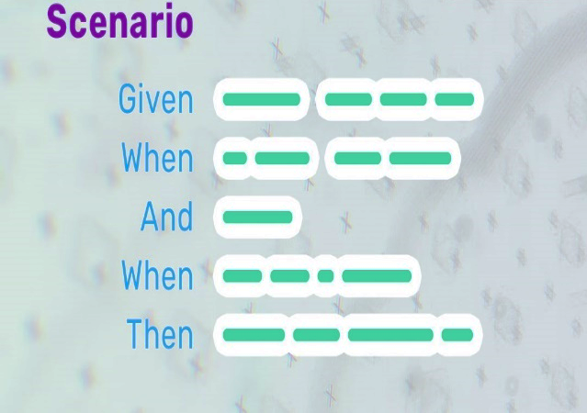
Languages Used
Java Script :
A lightweight , interpreted programming language. It is designed for creating network-centric applications. It is complimentary to and integrated with Java.
Gherkins Language in Feature file :
A plain English text language, which helps the tool - Cucumber to interpret and execute the test scripts.

Slide 7
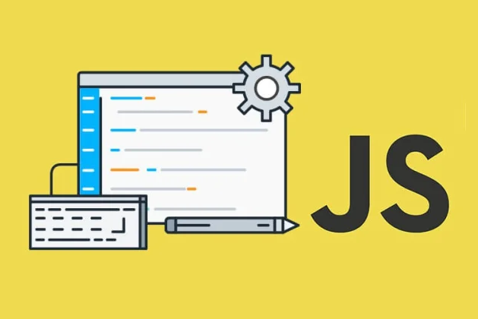
JavaScript
Important features of JavaScript:
Light weight scripting language
Dynamic typing
Object-oriented programming support
Functional style
Platform independent
Prototype-based
Interpreted language
Async processing
Client-side validation

Slide 8
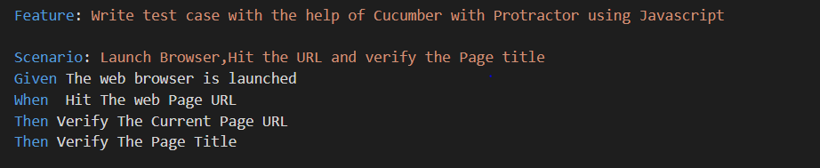
Gherkins Language
Gherkin is a language, which is used to write Features, Scenarios, and Steps. The purpose of Gherkin is to help us write concrete requirements
The keywords are −
Feature
Scenario
Given, When Then, And, But (Steps)
Background
Scenario Outline
Examples
""" (Doc Strings)
| (Data Tables)
@ (Tags)
# (Comments)
*

Slide 9
Tasks Done
All the Necessary Software have been Installed.
A Website with a lot of abstract features have been selected to test the application.
Necessary Test Cases have been designed to Test the Web Application.
Some of the features of the Website have been tested using automation frameworks previously mentioned
We have written Feature Files and Step definition for the feature file and configuration file to run the necessary automation script.

Slide 10
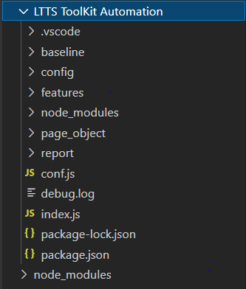

Slide 11
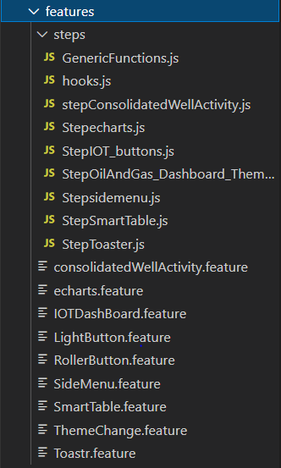
Feature files and Step Definitions

Slide 12
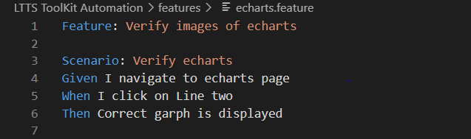
Feature File

Slide 13
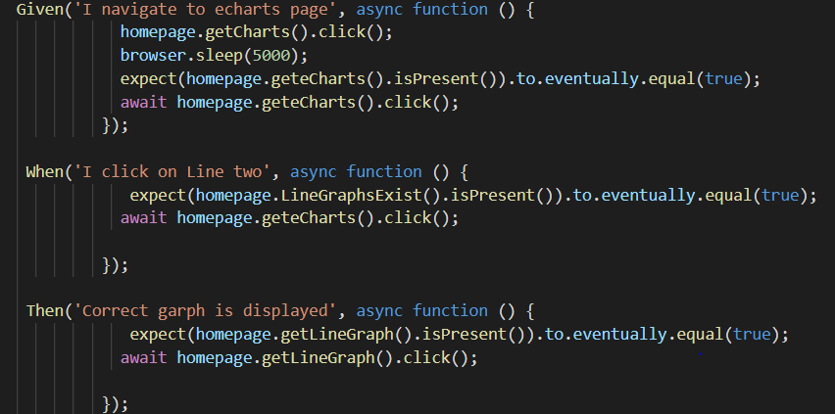
Step Definition.

Slide 14
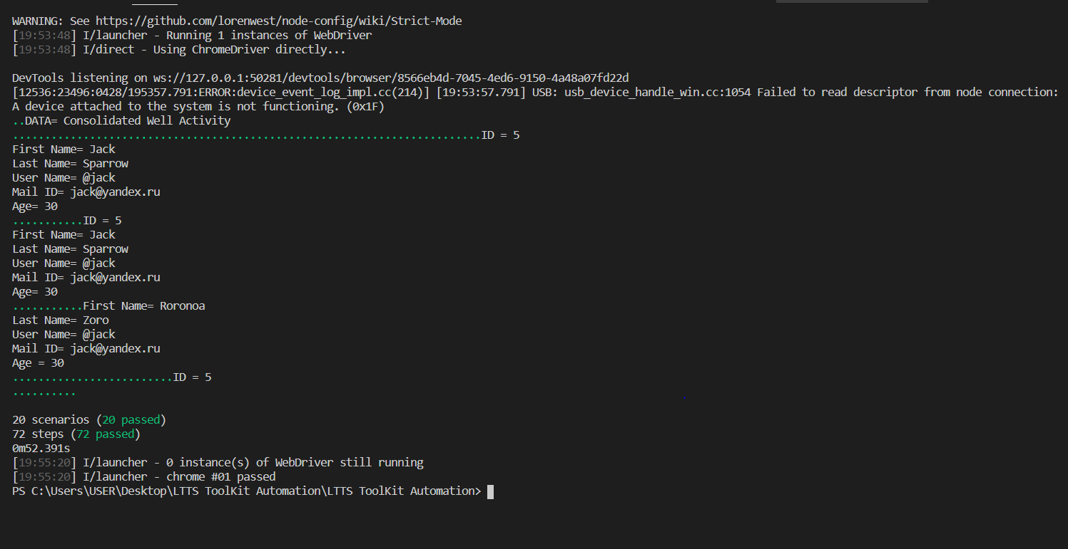

Slide 15
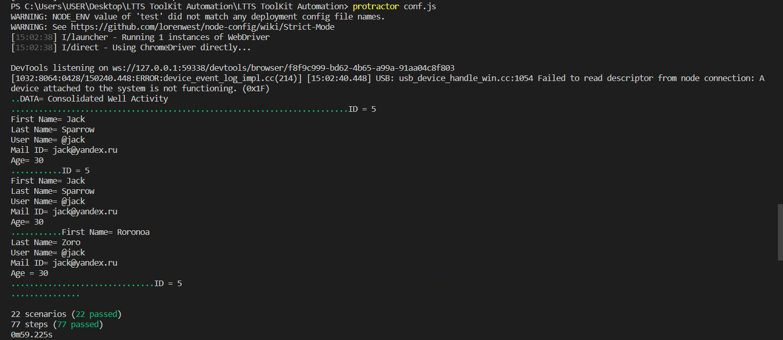
Results Obtained

Slide 16
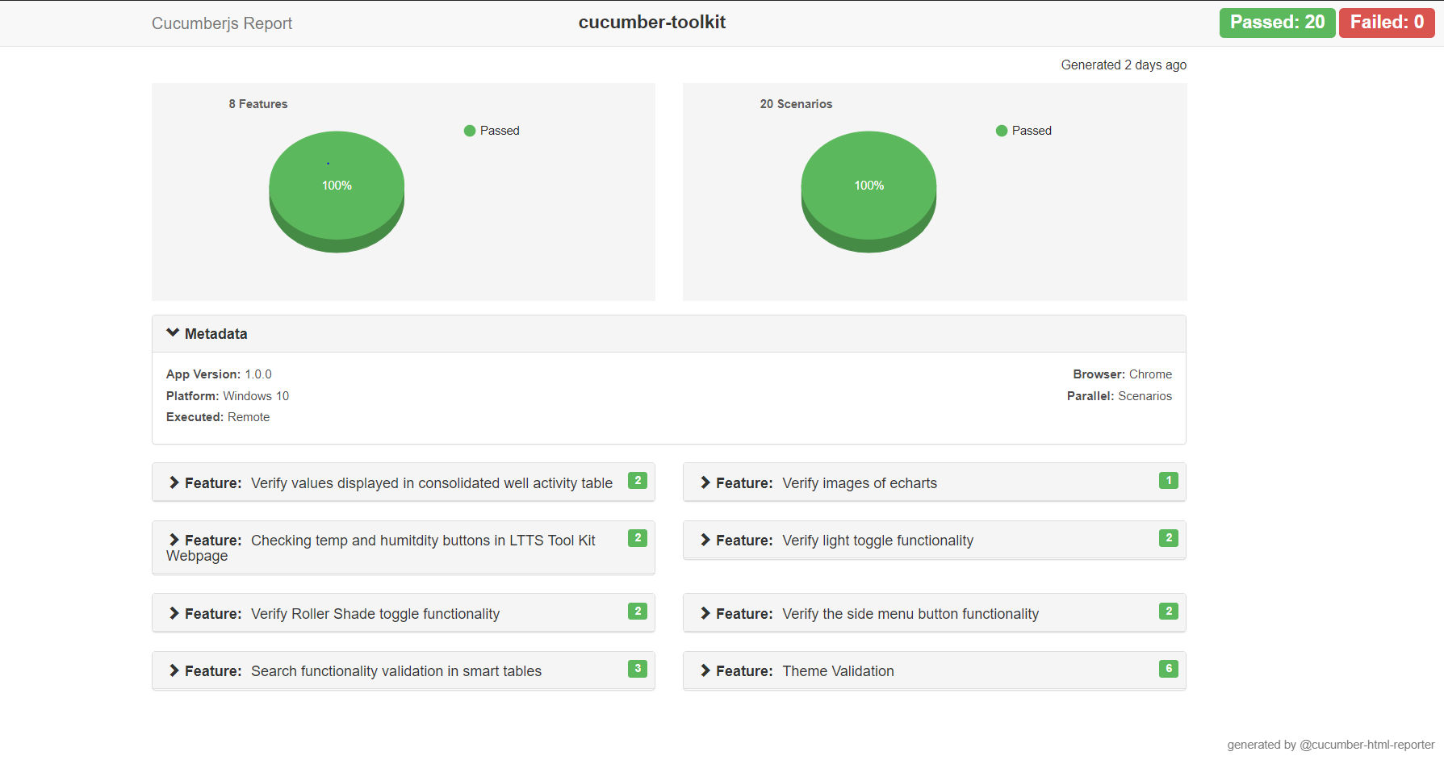

Slide 17
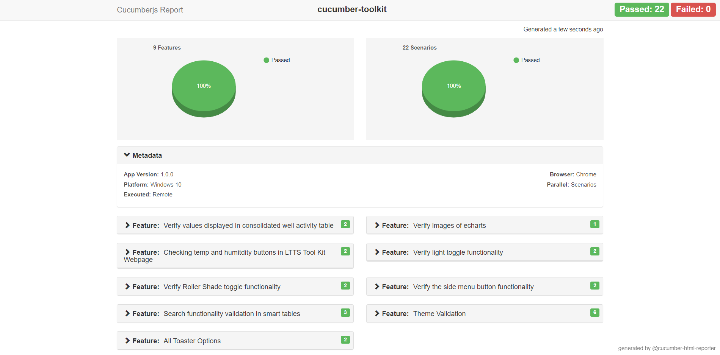
Report

Slide 18

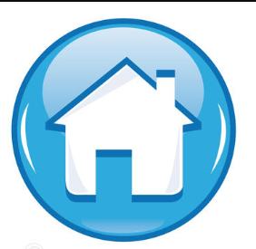
Thank You !

